Slide 1
Model Operationalization
With Governance and Model Risk Management
Open Data Science Conference (East) 2020
Sourav Mazumder
The Open Group Distinguished Data Scientist
ML Operationalization Leader
IBM Data and AI Expert Lab and Learning
smazumder@us.ibm.com https://www.linkedin.com/in/souravmazumder/
Shikhar Kwatra
IBM Master Inventor
ML Operationalization Architect
IBM Data and AI Expert Lab and Learning
skwatra@us.ibm.com
https://www.linkedin.com/in/shikharkwatra/
Join us in https://github.com/ibm-cloud-architecture/refarch-ml-ops
1

Slide 2
Agenda
Introduction to ML Operationalization
ML Operationalization - Process, Persona, Environments and Frameworks/Platforms
ML Operationalization in Action with Governance and Model Risk Management - Demonstration
Hands On (Self Paced)

Slide 3
What is ML Operationalization
“Creating an ML model is just a starting point. To bring the technology into production service, you need to solve various real-world issues such as building a data pipeline for continuous training, automated validation of the model, version control of the model, creating a scalable serving infrastructure, and ongoing operation of the ML infrastructure with monitoring and alerting.”
ML Operationalization
Continuous Training
Automated Validation and Deployment
Insight Infusion at Scale
Ensuring Transparency
Removing Bias
Business KPI Mapping
Model Risk Management
Forrester

Slide 4
ML Ops can be daunting with different challenges faced by different organizations
‘From Model conception to use in Production it takes any time between 48 to 60 weeks
‘Need to onboard large number of contractors, track the datasets used for developing Models, how the Models are providing Business Value’
‘How to use the platform to scale the Model to serve 10 M requests in a day and Monitor those requests’
‘Need to institutionalize collaborative approach involving multiple teams to deliver Models without Bias and ability to trace back Models’ Lineage’
‘How to setup a process to make auditors believe on the approach to arrive at Prediction’
‘Need a Framework to ramp up my Business Analysts in Data Science to churn Models fast for use by Actuaries’
‘Need to get Explanation for every case predicted as ‘Risk’ by I Risk Prediction Model

Slide 5

ML Operationalization – High Level Steps and Personas
ML Operationalization refers to operationalization of Machine Learning Models for production use to realize business value out of those Models.
ML Operationalization overlays paradigm of DevOps on Model Lifecycle management process (CRISP-DM)
Data Steward,
Data Engineer
Data Engineer,
Data Scientist
Data Scientist,
Business Analyst
Data Scientist,
Data Engineer
Data Engineer
Apps Developer
Data Engineer
Data Scientist
Data Engineer
5 Cs
Data Provisioning with Governance
Data Preparation for Model
Model Development
Model Validation & Governance
Model Deployment & Insight Consumption in Production
Model Monitoring
Continuous Training, Validation, Deployment, Integration & Monitoring
ML Operationalization
For Conceptual View of ML Ops please check - https://ibm.co/AI-Ops

Slide 6
ML Operationalization spread across Dev, UAT & Prod Environments
Data Sources
Consuming Applications
Data & Model Exploration
Virtualization
UAT Env
Prod Env
Scoring
Scoring
Data Preparation & Business Level Feature Engineering
Import & Deploy Model
Explanation
Explanation
Provisioning & Governance
Model Validation
(Fairness,Drift,Quality,Lineage)
Model Development
Import and Deploy Model
Model Monitoring
(Fairness, Drift)
Dev
UAT/Pre-Prod
Prod
CT/CD/CV/CI/CM
CT/CD/CV/CI/CM
CT/CD/CV/CI/CM
CT/CD/CV/CI/CM
External Repository Service
(Github/Bitbucket/SVN)

Slide 7
What to look for in ML Frameworks ?
Features | Description
Flexibility/Customizability | How flexible is the platform in integrating and/or customizing new frameworks for AI model development.
Ease of Use | How easy is it to leverage these tools and proposed techniques from setup to application.
Integrations | How well does the platform integrate with Git or other model versioning and source control tools, catalogs (for governance and discoverability) or various data sources.
Governance | How well does the solution support governance and discoverability of assets (data assets, models, notebooks, ...)
Platform | Support for various platforms (public cloud, on-prem, hybrid cloud), and compute types (CPU/GPU) for training and scoring (or inference) AI models
Monitoring | How well does the solution support monitoring AI models for performance / explainability / fairness
Scalability | How scalable is the platform in supporting various Data & AI users in different roles to explore, develop, and deploy AI models.
Openness | How well does the platform support open-source technologies which has become a key differentiator for platform providers.
Security | How well does the platform support enterprise-grade security access to the platform in terms of authorization and authentication
Support for 5 Cs | Support for Continuous Training, Validation, Deployment, Integration and Monitoring

Slide 8
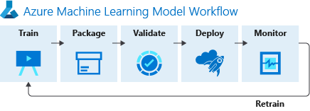
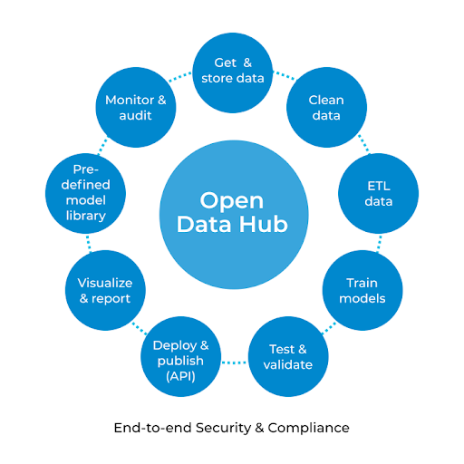
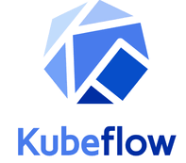
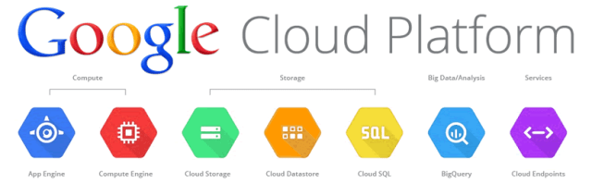
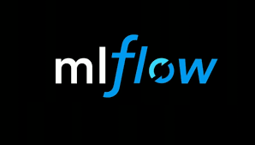

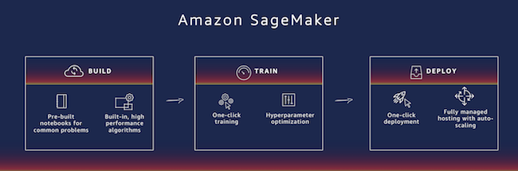
Popular ML Ops Tools and Frameworks
From Software Vendors
Open Source Frameworks

Slide 9



ML Operationalization with IBM Cloud Pak For Data
Consuming Applications
(Infusing AI)
Support for Python, Scikit Learn, R, R Studio, Jupyter Notebook, Jupyter Hub, Spark, Tensor Flow
Consuming Applications
(Infusing AI)
Consuming Applications
(Infusing AI)
Cloud Pak For Data
DEV Env
Data Provisioning
Data Preparation
Model Development
Monitoring (WOS)
Scoring (WML)
Data Scientist
Data Source Connections
Model Deployment (WML)
Data Steward
Data Sources
Model Development (Watson Studio)
Data Engineer
Auto AI
Notebooks
Decision Optimization
UAT/Pre-Prod Env
,
Model Deployment
Model Validation
Model Retraining
Data Sources
Continuous Integration & Deployment (CI/CD Service)
Data Engineer
Data Preparation (Watson Studio)
Data Scientist
Data Sources
Refinery
Notebooks
Modeler
Virtualized Data/Views (DV)
PROD Env
Model Deployment
Scoring
Model Monitoring
Cataloging & Governance of Data/Assets (WKC)
Data Engineer
Data Scientist
Open Hybrid Multicloud Platform
WS – Watson Studio
WML – Watson Machine Learning
WOS – Watson Open Scale
WKC – Watson Knowledge Catalog
DV – Data Virtualization
CI/CD – Continuous Integration &Deployment
IBM public cloud
AWS
Microsoft Azure
Google Cloud
Private
IBM Z IBM LinuxOne IBM Power
IBM Storage
Endpoints

Slide 10

ML Ops In Action (1/2) - Data Provisioning and Governance
Data Request Creation
Requests Datasets/Tables to support a Data Science Use case.
Provides Key Words
Data Scientist
Daily Data Discovery
Creates Connections to Data Sources
Schedules Nightly Discovery of Meta Data across Data Source. Adding to Workspace & Catalog
Reviews results
Adds Business Terms, Policies, Rules
Data Identification
Searches Workspace for Datasets/Tables those Match Data Scientist’s Data Request
Shortlists Datasets
Creates Use case specific Catalog
Provides Data Scientist & Data Engineer access to the Catalog
Data Virtualization
Adds Data Source connection to the Virtualization if not there
Virtualize the Datasets
Provides Data Engineer access to Virtualization Dataset
Target Dataset Provisioning
Creates Target Dataset based on Virtualized Data.
Joins/Filters Datasets as needed
Adds Virtualized Datasets to Project requested by Data Scientist
Adds Virtualized Datasets to Catalog
Data Steward
Target Dataset Preparation
Creates Target Dataset based on Virtualized Data.
Joins/Filters Datasets as needed
Target Dataset Provisioning
Adds Virtualized Datasets to Project requested by Data Scientist
Adds Virtualized Datasets to Catalog
Data Engineer

Slide 11
ML Ops In Action (2/2) - Model Development, Deployment & Monitoring
Data Preparation and Feature Engg
Access Data From Catalog
Does necessary Data Transformation & Cleansing
Creates Final Dataset for Model development
Model Development
Creates Initial Model
Tests Model
Iterates to finalize Model
Model Monitoring
Configures Model For Monitoring (Bias, Quality, Drift & Explainability)
Monitors Results on Regular basis
Data Scientist
Model Deployment for Validation
Creates Deployment Space in UAT/Pre-Prod Env
Deploys Model to Deployment Space in UAT/Pre-Prod Env
Model Deployment in Production
Creates Deployment Space in Production Environment
Deploys Model to Deployment Space in Prod Env
Data Engineer
Model Validation/Risk Management
Creates Dataset for Independent Validation
Independent Validation of Model
Provides feedback or Certifies Model
Model Factsheet
Validators

Slide 12
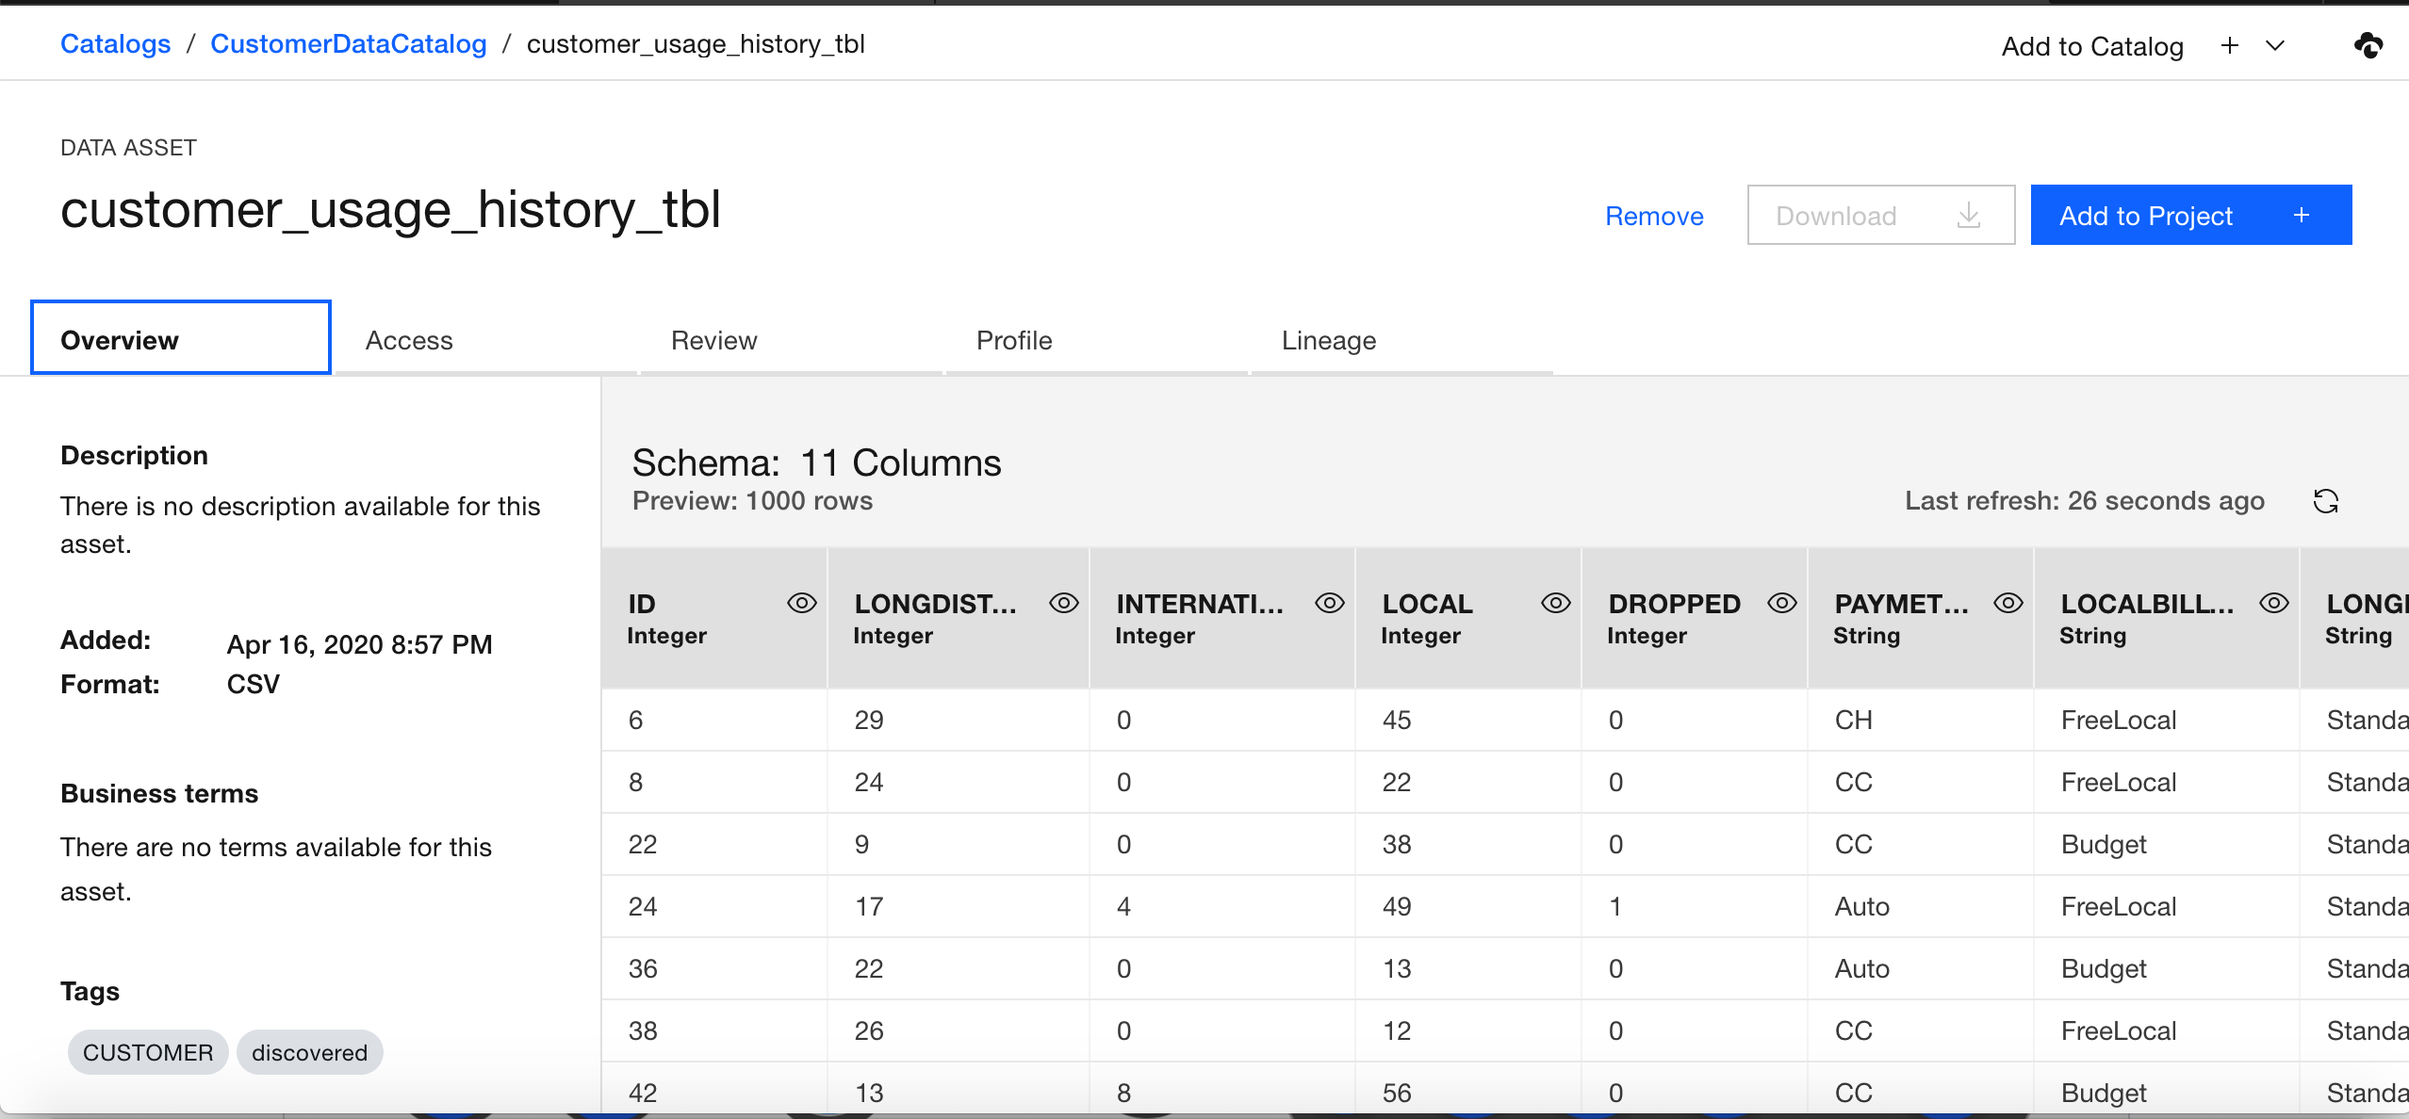
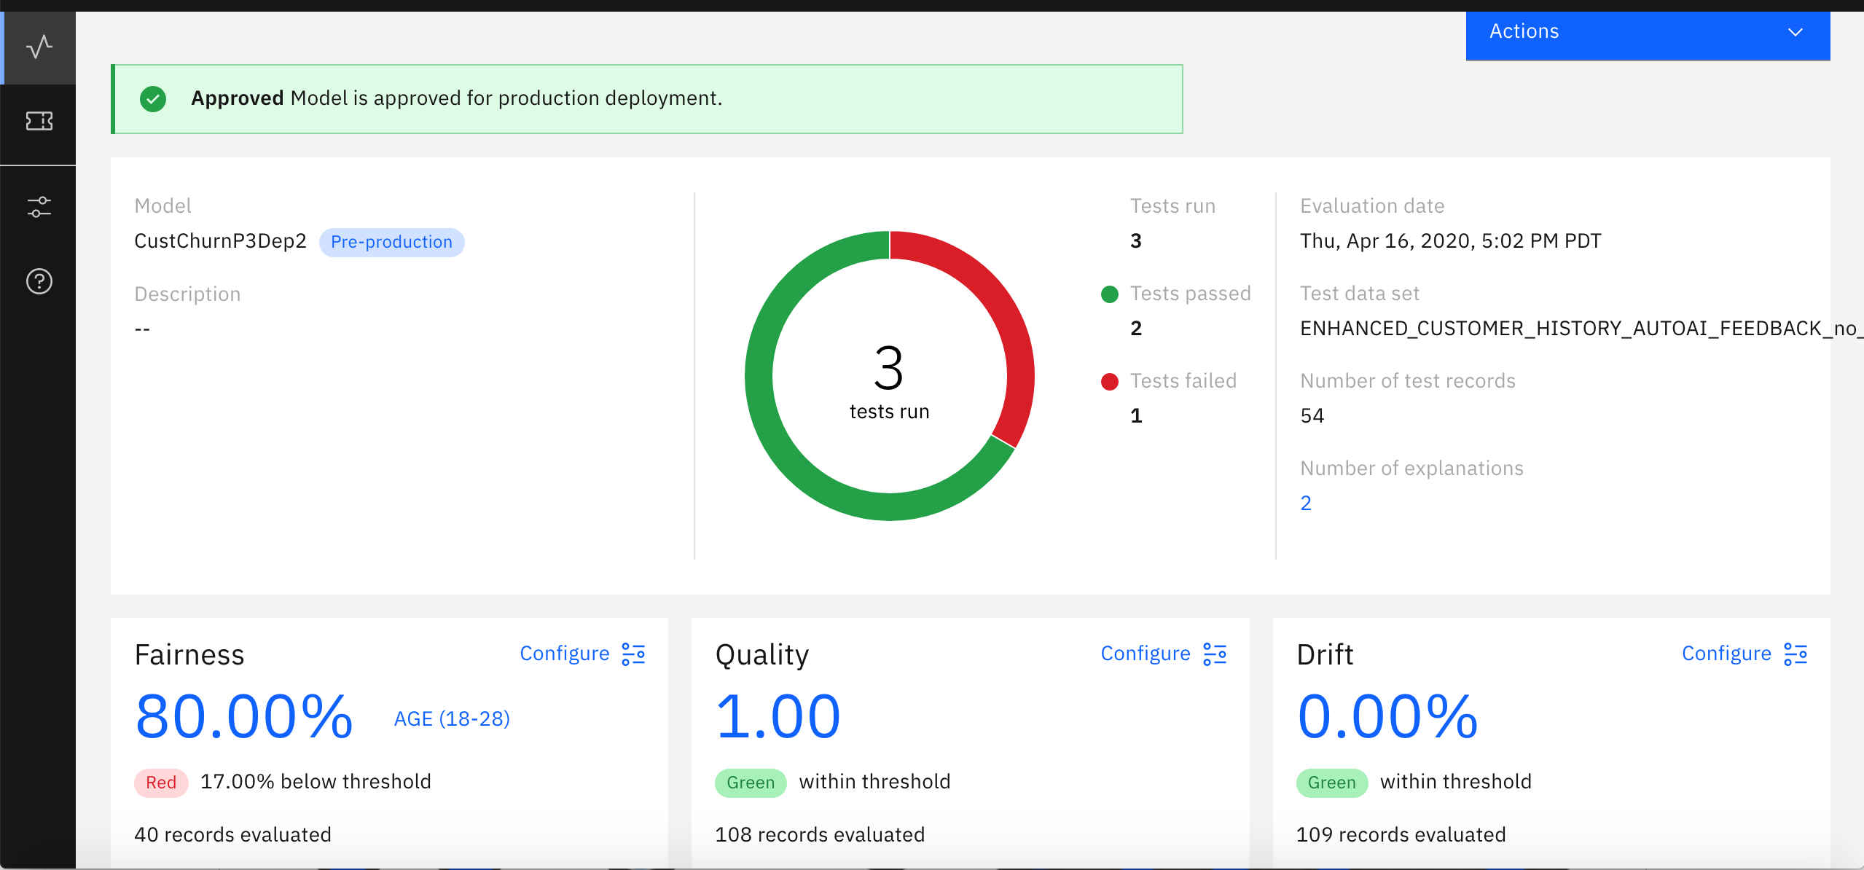
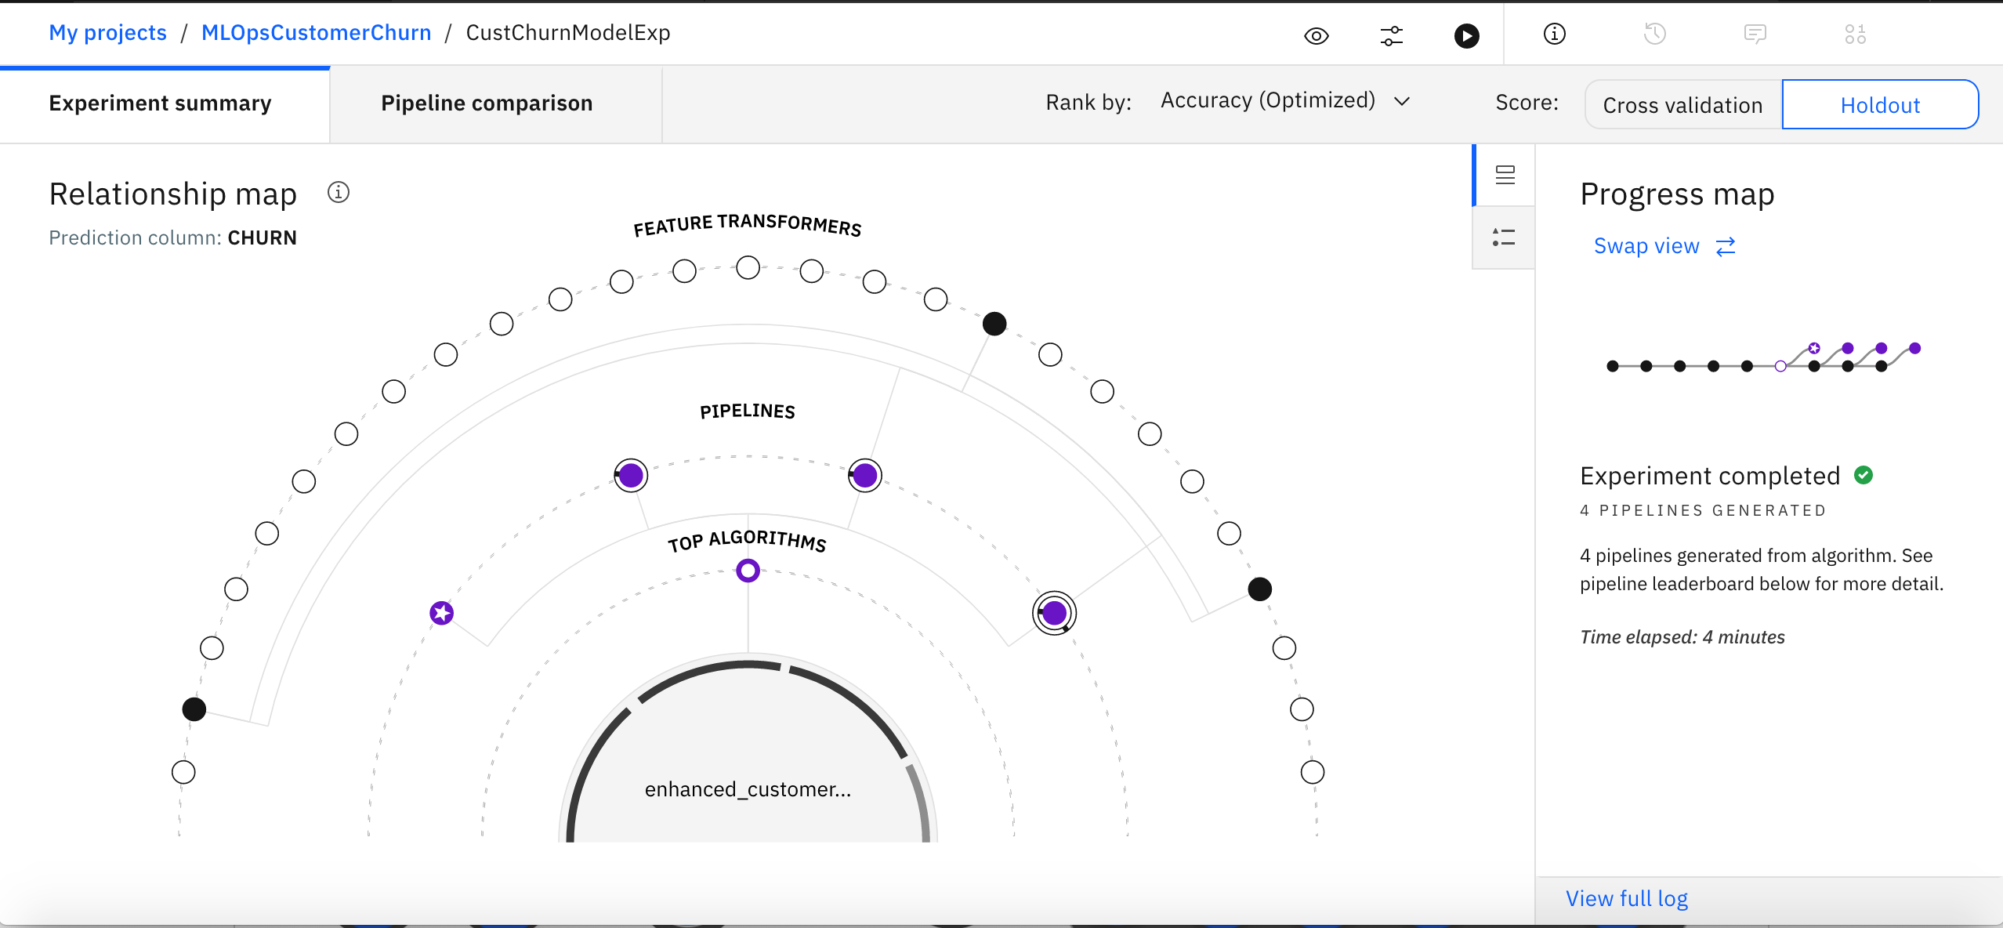
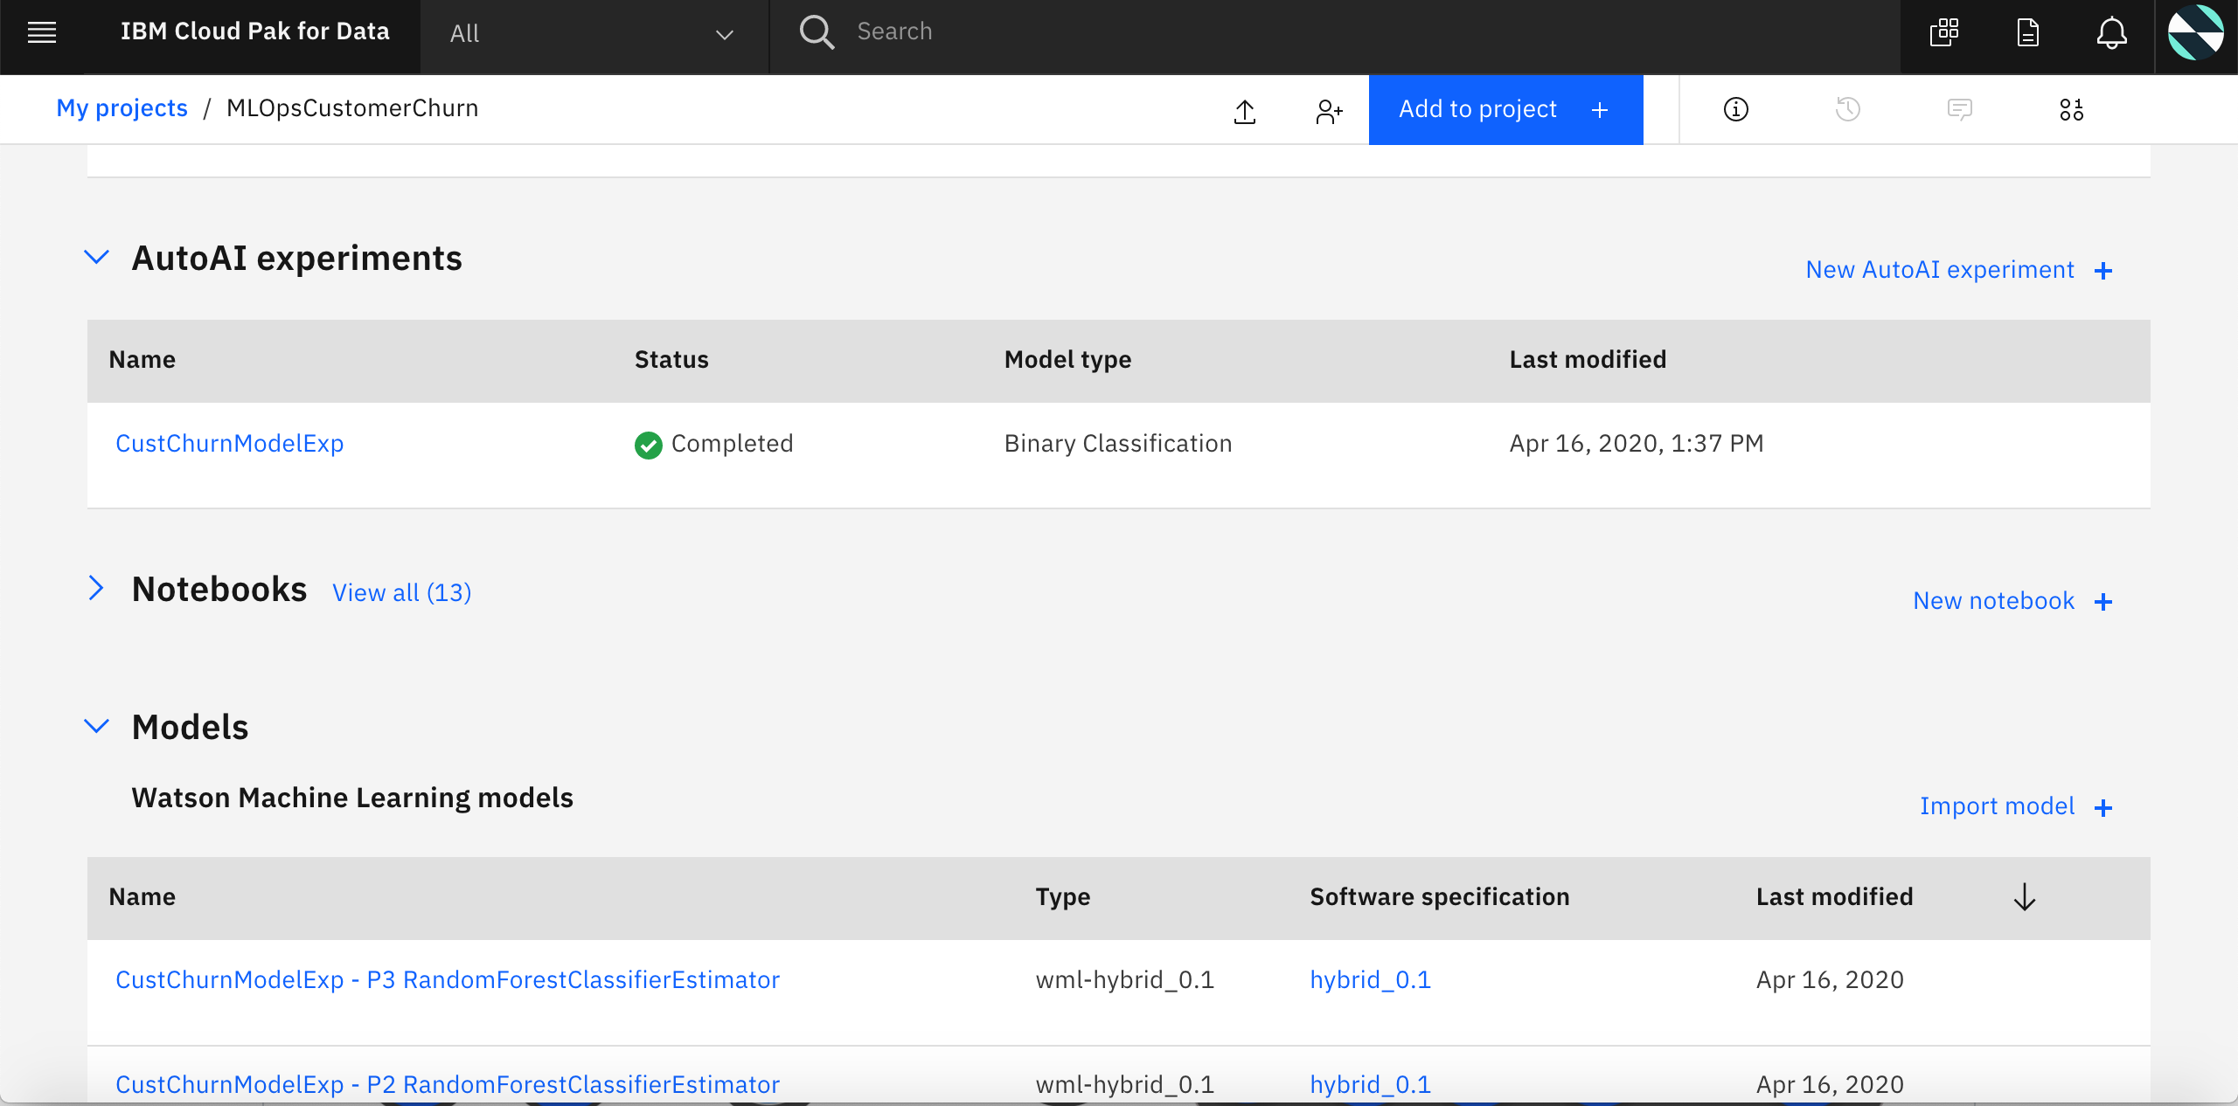
ML Ops - Demonstration

Slide 13
ML Ops – Self paced Hands On
Go to IBM Cloud Architecture Center - https://www.ibm.com/cloud/architecture/architectures/dataAIArchitecture/solutions
Click on the tile ‘Drive business results from your machine learning Models’ in Solution section
In the next page click on Get the Code – this will take you to Public Github fro MLOps
Go through the ReadMe. In How to get Started section click on the link for Cloud Pak For Data Experience. There you will have the instruction to get your free cluster for Cloud Pak For Data. Follow the instruction and get your Cloud Pak For Data Experience cluster (takes 5 minutes)
Go through the rest of the steps in section ‘How to get Started’ to get started with your self paced Hands On

Slide 14
Getting Started with ML Operationalization using ML Ops Starter Kit
End 2 End framework to help get started with ML Operationalization
Data Steward,
Data Engineer
Data Engineer,
Data Scientist
Data Scientist,
Business Analyst
Data Scientist,
Data Engineer
Data Engineer
Apps Developer
Data Engineer
Data Scientist
Data Engineer
Dev
Dev
Dev
UAT/Non-Prod
Prod
Prod
Continuous Training,
Validation, Deployment, Integration & Monitoring
Data Provisioning with Governance
Data Preparation for Model
Model Development
Model Validation & Governance
Insight Consumption in Production (Infuse)
Model Monitoring
ML Operationalization
ML Ops Starter Kit
Instructions
Code
Configurations
Data
Best Practices
1 Click Import
1 Click Configuration
Cloud Pak For Data
Other ML Ops Frameworks
Components/services
Watson Knowledge Catalogue
Watson Studio
Watson Machine Learning
Watson Open Scale
Data Virtualization
Dev/Non-Prod Edition
Standard Edition
Enterprise Edition
One Enterprise Edition
Cloud Pak For Data Experience
(Community Version)

Slide 15
Let us Discuss more about ML Ops
Q and A
Join us in https://github.com/ibm-cloud-architecture/refarch-ml-ops

Slide 16
Thank You
16

